Slide 1

Adhiyamaan College of Engineering (Autonomous) Department of Mechanical Engineering
DESIGN AND FABRICATION OF MAGNETIC BEARING
PROJECT MEMBERS
1.M.GANAPATHY [AC12UME043]
2.S.JAGADESH [AC12UME055]
3.A.JAVED HUSSAIN [AC12UME056]
4.S.JEAN AUSTIN [AC12UME058]
UNDER THE GUIDANCE OF:
Prof. VINAYAK MUDHOL. M.Tech.,
ASSISTANT PROFESSOR
DEPARTMENT OF MECHANICAL ENGINEERING,
ADHIYAMAAN COLLEGE OF ENGINEERING, HOSUR

Slide 2
ABSTRACT:
DESIGN AND FABRICATION OF MAGNETIC BEARING
Generally bearings are used to place shaft stable and transmit rotatory motion from one part to another without any losses. There are various types of bearing used in rotatory transmission such as ball bearing, roller bearing, jewel bearing, taper bearing, journal bearing. All these bearing are required lubrication.
Our project deals with design and fabrication of magnetic bearing, this bearing replaces the above bearings by no lubrication purposes and produce very less amount of friction.

Slide 3
INTRODUCTION:
DESIGN AND FABRICATION OF MAGNETIC BEARING
A magnetic bearing is a bearing that supports a load using magnetic levitation. Magnetic bearings support moving parts without physical contact. For instance, they are able to levitate a rotating shaft and permit relative motion with very low friction and no mechanical wear. Magnetic bearings are used in several industrial applications such as electrical power generation, petroleum refinement, machine tool operation and natural gas handling.

Slide 4
OBJECTIVE:
DESIGN AND FABRICATION OF MAGNETIC BEARING
To design and fabricate magnetic bearing using Neodymium Iron Boron (NdFeB) magnet.

Slide 5
LITERATURE REVIEW:
DESIGN AND FABRICATION OF MAGNETIC BEARING
S.NO | TITLE | AUTHOR NAME | DESCRIPTION | YEAR
1. | Control Parameters of Active Magnetic Bearing Supporting Rotating System | Luiz de Paula do Nascimento, Carlos Henrique de Olivira Arantes | To improve the exciting force of rotating system supported by Active Magnetic Bearing(AMB) | August , 2014
2. | Active Magnetic Bearing System Identification Using Current-Position Perturbation | Jianhui Zhao, Mary E.F.Kasarda, Dewey Spangler, Robert Prins. | Improved the Active Magnetic Bearing (AMB) by placing a sensor in air gap | September,2012

Slide 6
DESIGN AND FABRICATION OF MAGNETIC BEARING
S.NO | TITLE | AUTHOR NAME | DESCRIPTION | YEAR
3. | Torque Calculation And Analysis of Permanent –Magnetic Gears | Yang Zhiyi, Zhao Han. | Permanent-magnetic gears are replaced the ordinary mechanical gears and to transmit torque without mechanical contact. | March,2011
4. | The Cycloid Permanent Magnetic Gear | Frank T. Jorgensen, Peter Omand Rasmussen. | A new permanent-magnet gear based on the cycloid gearing principle, which is of extreme torque density and very high gearing ratio. | December, 2008

Slide 7
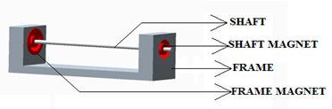

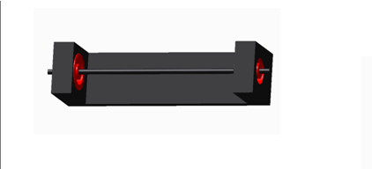
3D MODEL OF MAGNETIC BEARING:
DESIGN AND FABRICATION OF MAGNETIC BEARING

Slide 8
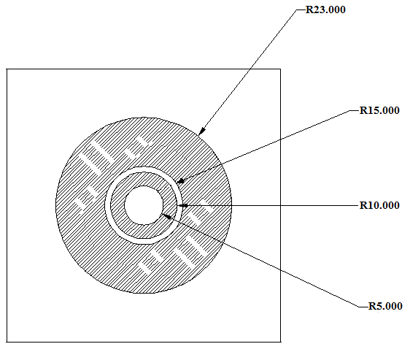
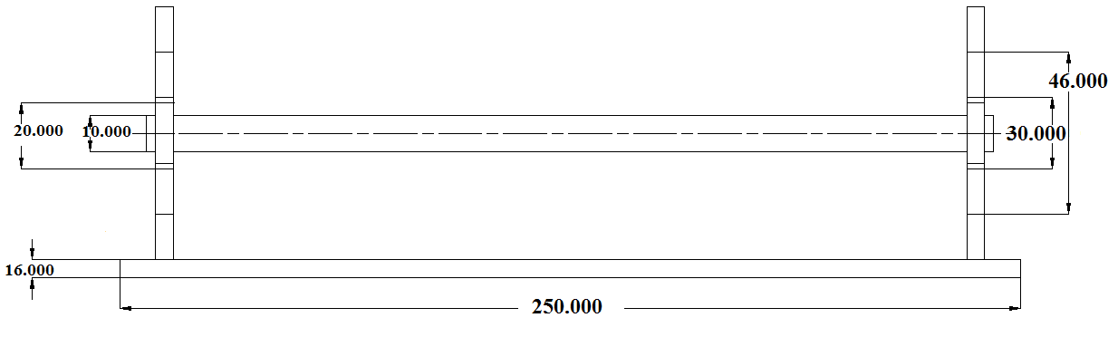
2D MODEL OF MAGNETIC BEARING:
DESIGN AND FABRICATION OF MAGNETIC BEARING

Slide 9
DIMENSIONS:
DESIGN AND FABRICATION OF MAGNETIC BEARING
Frame magnet:
Outer radius(R_{a}) = 23mm
Inner radius (R_{i}) = 15mm
Shaft magnet:
Outer radius (r_{a}) = 10mm
Inner radius (r_{i}) = 5 mm
Thickness of magnets (D) = 16mm
Length of axle (L) = 250mm
Diameter of shaft (D_{s}) = 10mm
Distance between magnets(Z) = 10mm

Slide 10
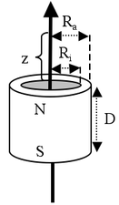
DESIGN CALCULATION:
DESIGN AND FABRICATION OF MAGNETIC BEARING
Formula for the B field of ring magnet:
(http://www.supermagnete.de/eng/faq/How-do-you-calculate-the-magnetic-flux-density)
B_{r}: Remanence field, independent of the magnet's geometry (see physical magnet data)
D: Thickness (or height) of the ring
z: Distance from a pole face on the symmetry axis
R_{a}: Outside radius of the ring
R_{i}: Inside radius of the ring

Slide 11
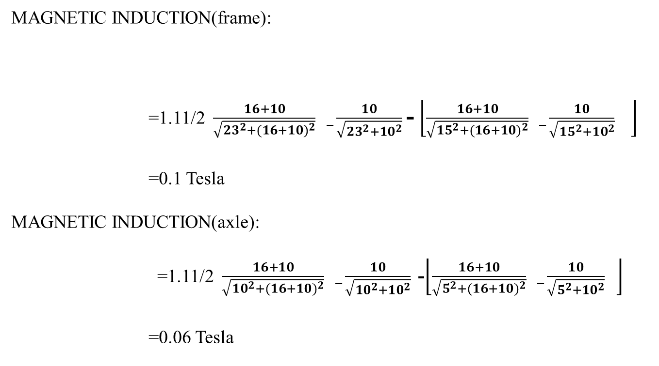
DESIGN CALCULATION:
DESIGN AND FABRICATION OF MAGNETIC BEARING
MAGNETIC INDUCTION(frame):
=1.11/2$\frac{16+10}{\sqrt{{23}^{2}+{(16+10)}^{2}}} _\frac{10}{\sqrt{{23}^{2}+{10}^{2}}}$- $\left\lfloor \frac{16+10}{\sqrt{{15}^{2}+{(16+10)}^{2}}} _\frac{10}{\sqrt{{15}^{2}+{10}^{2}}} \right\rfloor$
=0.1 Tesla
MAGNETIC INDUCTION(axle):
=1.11/2$\frac{16+10}{\sqrt{{10}^{2}+{(16+10)}^{2}}} _\frac{10}{\sqrt{{10}^{2}+{10}^{2}}}$ -$\left\lfloor \frac{16+10}{\sqrt{5^{2}+{(16+10)}^{2}}} _\frac{10}{\sqrt{5^{2}+{10}^{2}}} \right\rfloor$
=0.06 Tesla

Slide 12
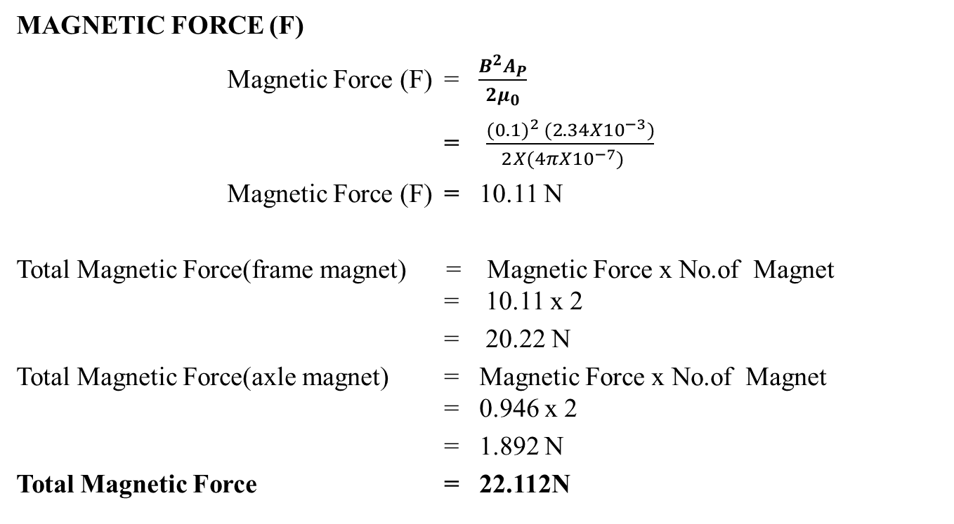
DESIGN CALCULATION:
DESIGN AND FABRICATION OF MAGNETIC BEARING
MAGNETIC FORCE (F)
Magnetic Force (F) = $\frac{B^{2}A_{P}}{2μ_{0}}$
= $\frac{{(0.1)}^{2} ({2.34X10}^{−3})}{2{X{(4πX10}^{−7})}_{}}$
Magnetic Force (F) = 10.11 N
Total Magnetic Force(frame magnet) = Magnetic Force x No.of Magnet = 10.11 x 2
= 20.22 N
Total Magnetic Force(axle magnet) = Magnetic Force x No.of Magnet = 0.946 x 2
= 1.892 N
Total Magnetic Force = 22.112N

Slide 13

LOAD CALCULATION:
DESIGN AND FABRICATION OF MAGNETIC BEARING
LOAD CARRYING CAPACITY
Load carrying capacity = $\frac{Total Magnetic Force}{9.81}$
= 22.112/9.81
Load carrying capacity = 2.25 kg

Slide 14
LOAD CARRYING CAPACITY FOR VARIOUS TYPES OF MAGNETS
DESIGN AND FABRICATION OF MAGNETIC BEARING
TYPE OF MAGNET | GRADE | Br VALUE (Tesla) | MAGNETIC INDUCTION (Tesla) | LOAD CARRYING (kg)
NdFeB | N-EECN52 | 1.42 | 0.397 | 18.79
Alnico | LNG52 | 1.3 | 0.363 | 15.60
NdFeB | EH-EECN35EH | 1.2 | 0.334 | 13.33
Samarium cobalt | EEC2:17-33 | 1.17 | 0.3265 | 6.37
Alnico | FLNG34 | 1.1 | 0.307 | 11.22

Slide 15
FABRICATION PROCEDURE
DESIGN AND FABRICATION OF MAGNETIC BEARING
General procedure for fabricating a magnetic bearing is one magnet should be placed on the frame and be clamped.
The machining is done for stainless steel shaft like turning, facing and threading.
Another magnet should be placed on the shaft with same poles which repulse each other.
Drilling is done in wood piece and frame magnet is clamped with nut and bolts.
Place the shaft in between the frame magnet.

Slide 16
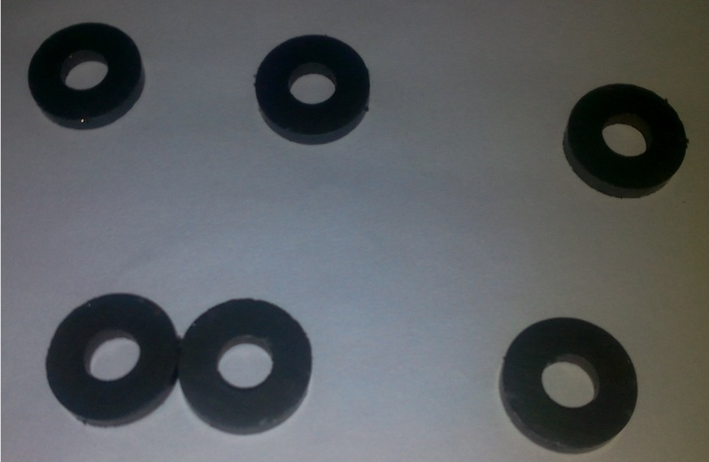
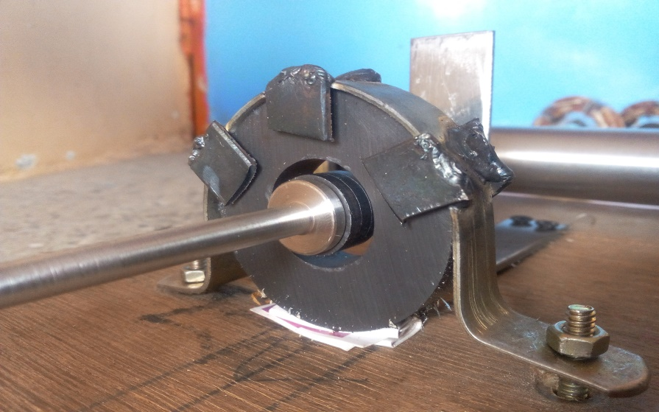
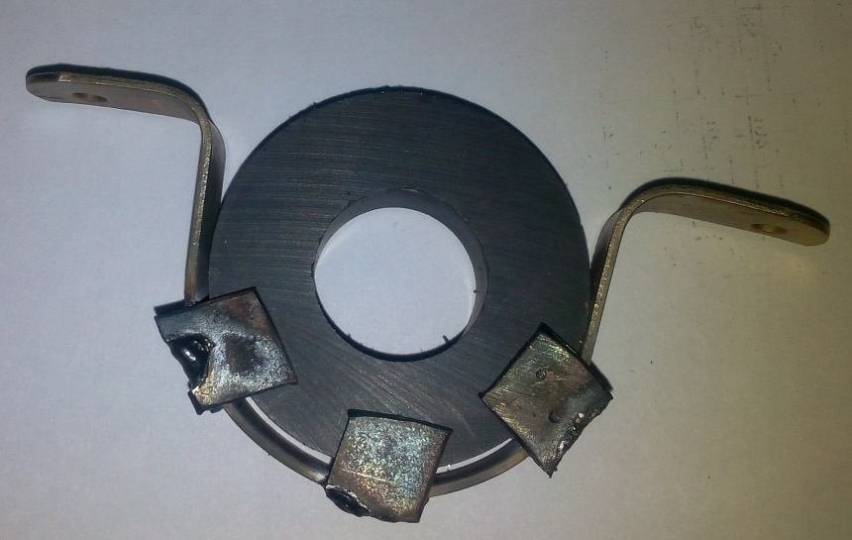
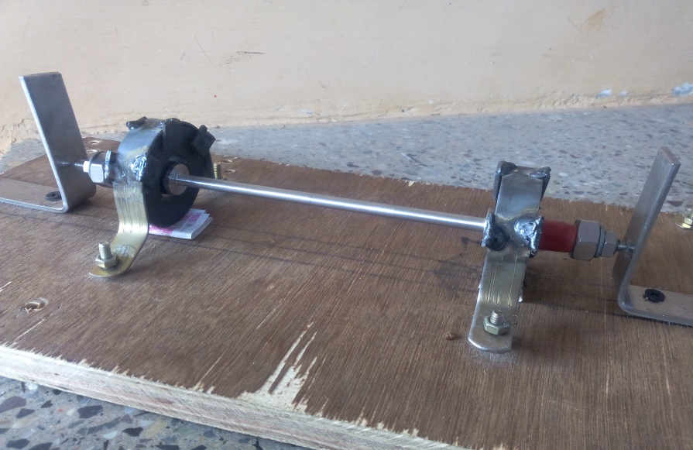
FABRICATED SETUP:
DESIGN AND FABRICATION OF MAGNETIC BEARING

Slide 17
COST ESTIMATION:
DESIGN AND FABRICATION OF MAGNETIC BEARING
COMPONENTS | COSTS (Rs)
Magnets | 500
Stainless steel shaft | 200
Wood | 100
Shaft machining | 400
Carpentry works | 100
Nuts, Bolts, Clamps | 100
TOTAL | Rs.1,400

Slide 18
RESULT AND DISCUSSION:
DESIGN AND FABRICATION OF MAGNETIC BEARING
The project was done with various machining processes such as turning, facing, drilling and threading.
From this project we have learnt that the magnetic bearing can be done by using ring type permanent magnet.
As the grade of magnets increases magnetic field also get increases and stiffness of magnet is also get increased.

Slide 19
CONCLUSION:
DESIGN AND FABRICATION OF MAGNETIC BEARING
In order to transfer power through bearing, lubrication is required to avoid friction between rotating parts hence magnetic bearing is used to avoid friction between rotating parts without lubricating parts.

Slide 20
REFERENCES:
DESIGN AND FABRICATION OF MAGNETIC BEARING
Pranab Samanta and Harish Hirani ,”Magnetic Bearing Conﬁgurations: Theoretical and Experimental Studies” Department of Mechanical Engineering, Indian Institute of Technology Bombay, Powai, Mumbai
Torque Calculation and Analysis of Permanent-Magnetic Gears Yang Zhiyi, Zhao Han School of Mechanical and Automotive Engineering, Hefei University of Technology
www.supermagnete.de/eng/faq/how-do-u-calculate-the-magnetic-flux-density.

Slide 21
THANK YOU

